Slide 1

Student Guide
Neha Naik
Suraj Nair
Amit Pathare
T.E.-CMPN-B
St. Francis Institute of Technology

Slide 2
Content
Introduction
Problem Statement
Literature Survey
Proposed Work
Implementation
Summary
References
Student Guide
2
Notes:
2

Slide 3
Introduction
The software system being produced is an android application for college going students which is called as Student Guide.
It is being produced for a college students interested in keeping track of their assignments and other such features and also for faculty members to upload notes and important dates.
Student Guide
3
Notes:
3

Slide 4
Problem Statement
Student Guide provides the functionalities that a student might need throughout their student/college life. The application would provide the students with an interface to interact with the teachers to clear doubts, access study materials like presentations, read notices from the notice section, receive reminders for submissions due.
Student Guide
4
Notes:
4

Slide 5
Literature Survey
My Study Life - School Planner
Student Planner
There are a few existing applications like these which provide limited functionalities and thus a student might end up using multiple applications for the same purpose.
Student Guide
5
Notes:
5

Slide 6
Proposed Work
Our proposed system- Student Guide will help allow students stay in touch with their academic life on the go at the click of a few buttons.
There are basically two modules: 1] STUDENT
2] FACULTY
The functional modules are: 1] Registration
2] Login
3] Chat
4] File sharing
5] Reminders
Student Guide
6
Notes:
6

Slide 7
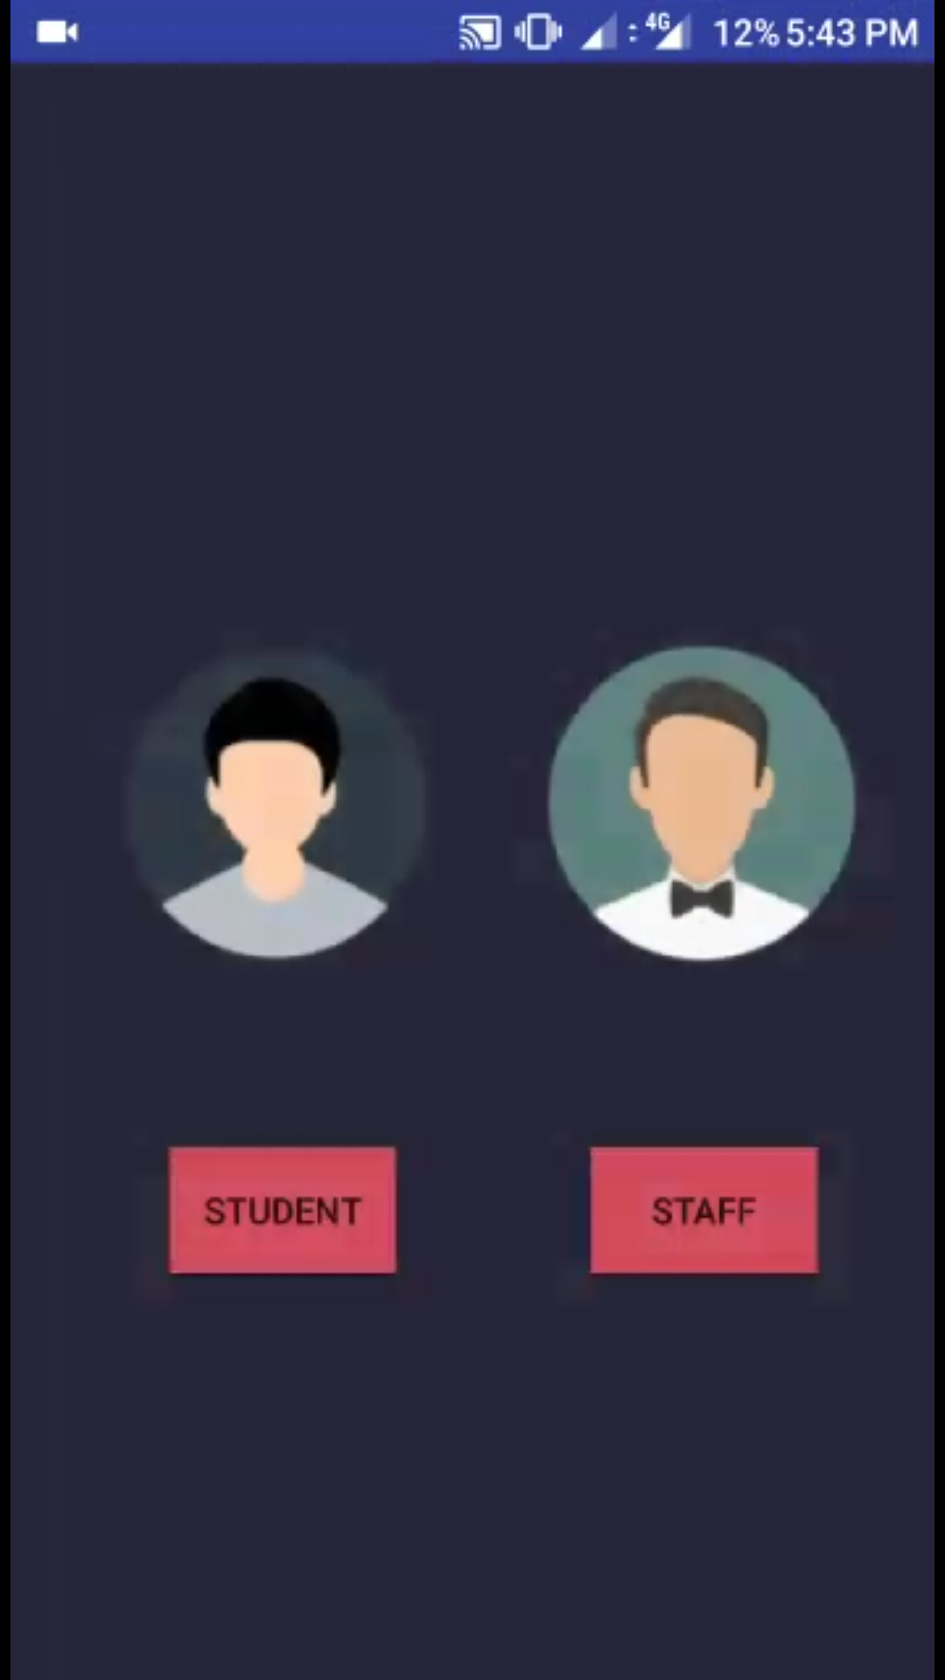
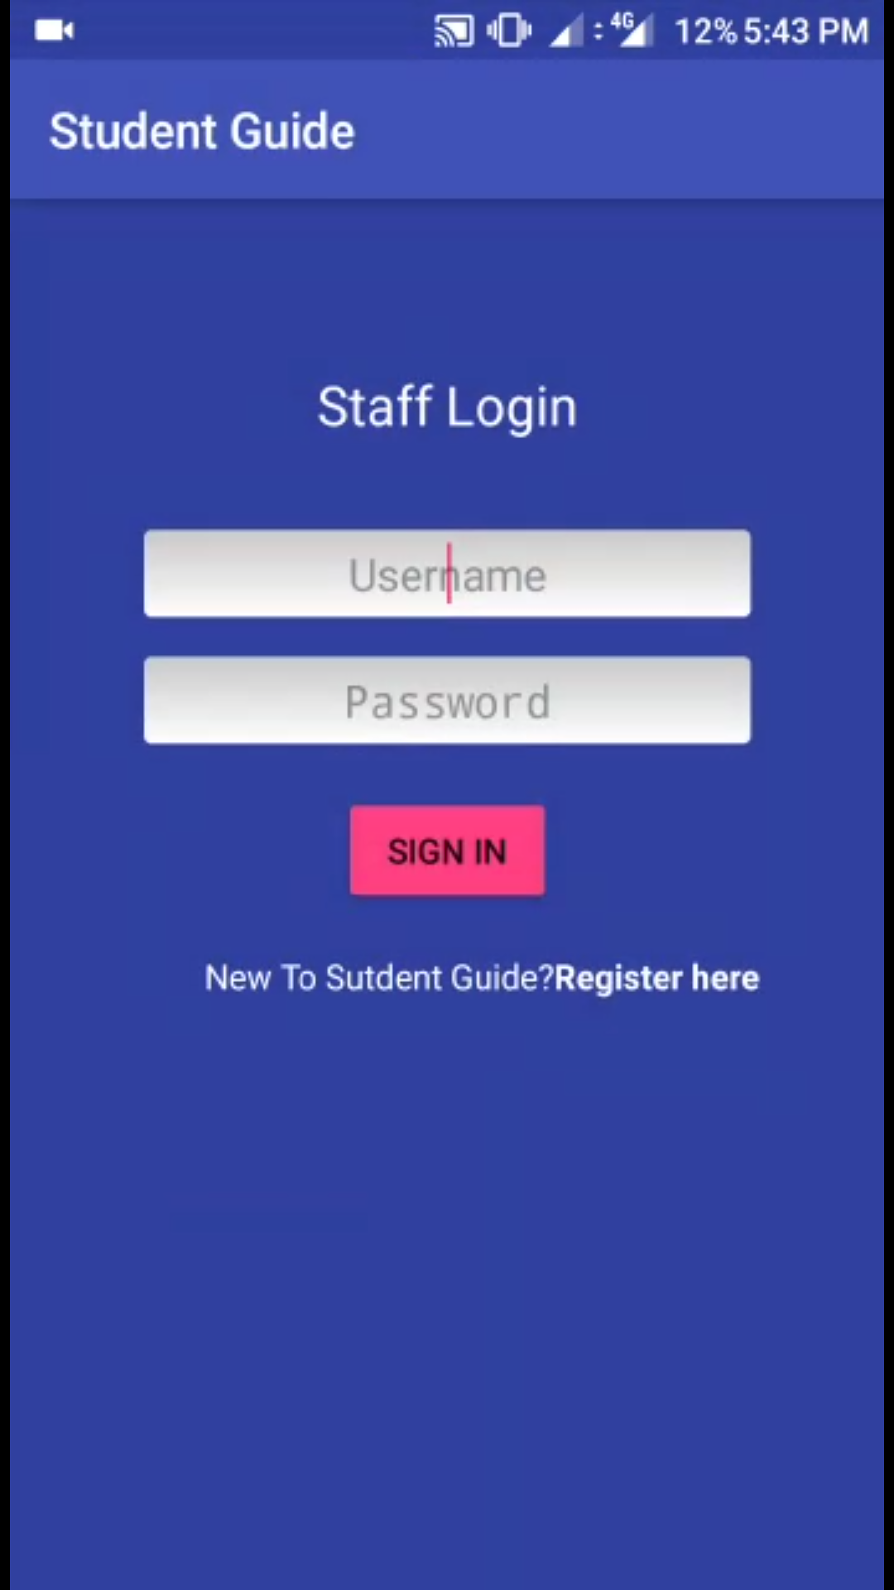
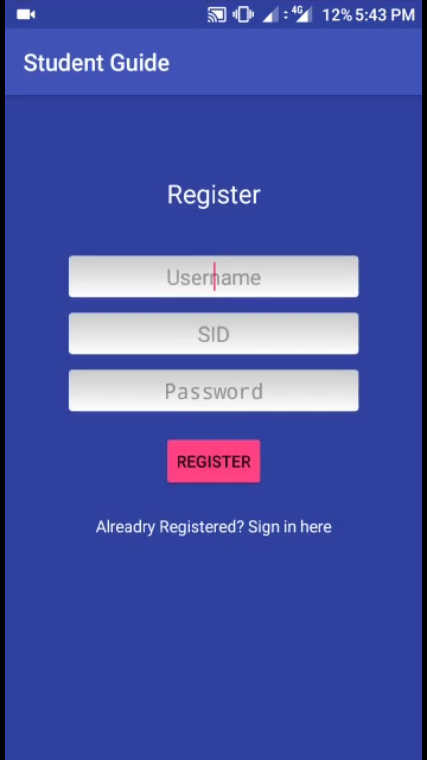
Implementation
Fig 1. Home Page
Fig 2. Staff Login Page
Fig 3. Staff Register Page
Student Guide
7
Notes:
7

Slide 8
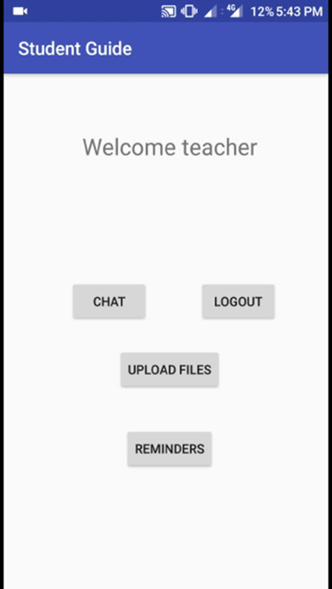
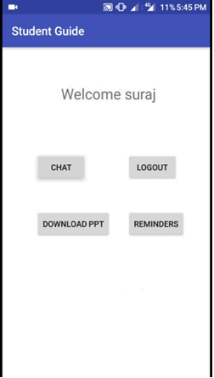
Implementation
Fig 4. Staff Dashboard
Fig 5. Student Dashboard
Student Guide
8
Notes:
8

Slide 9
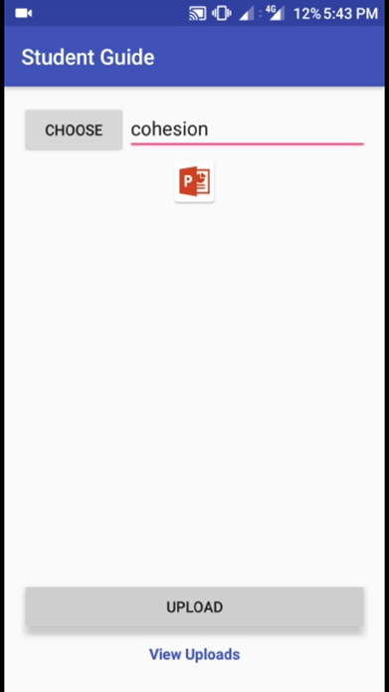
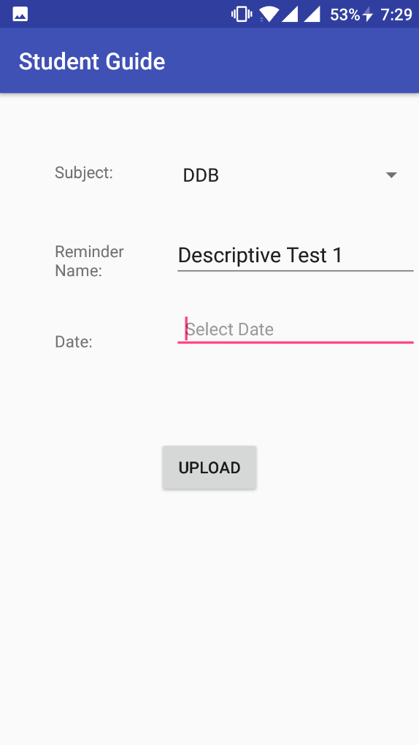
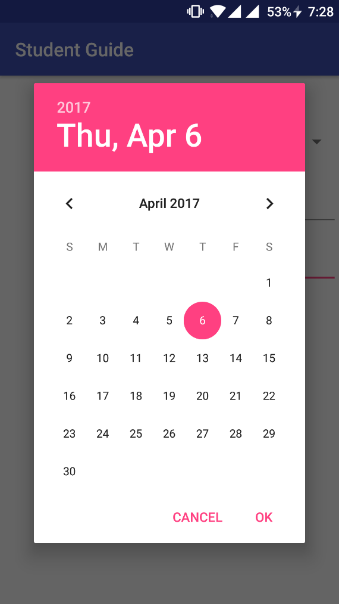
Implementation
Fig 6. File Upload
Fig 7. Reminder
Student Guide
9
Notes:
9

Slide 10
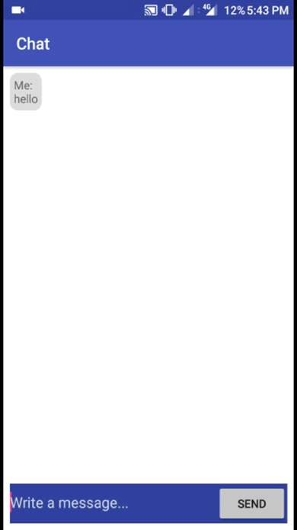
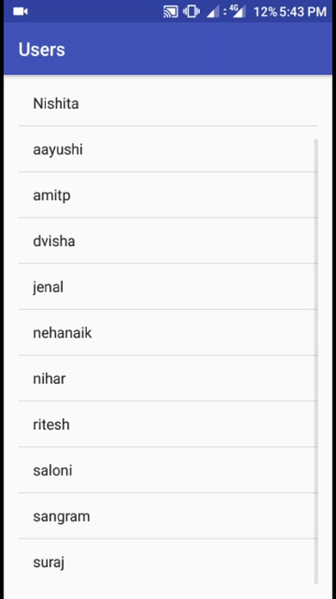
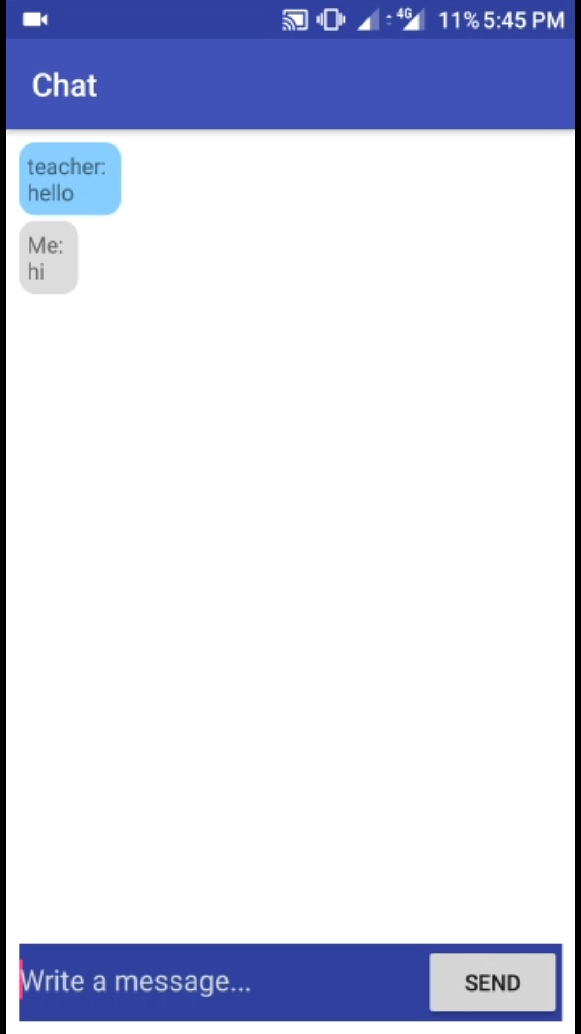
Implementation
Fig 8. Staff Chat
Fig 9. Chat Module
Fig 10. Student Chat
Student Guide
10
Notes:
10

Slide 11
Implementation
Fig 11. File Upload

Slide 12
Implementation
Fig 12. File Download

Slide 13
Summary
The first version of our app, Student Guide, has been made ready.
There are few features which can be incorporated into the later versions of this app.
The app was built using Android Studio and the database used is Firebase.
Student Guide
13
Notes:
13

Slide 14
Summary
For Mobile Communication and Computing (MCC), we have implemented the Student Guide app, which is an android application.
For Software Engineering (SE), we have implemented the Student Guide app, which is an android application.
For Distributed Databases (DDB), the concept of having the server and clients at different sites has been implemented.
For Networks Programming Laboratory (NPL), we have implemented file transfer and chat module which connects any two devices having the Student Guide app.
Student Guide
14
Notes:
14

Slide 15
References
Tutorials Point – Simply Easy Learning [https://www.tutorialspoint.com/android/android_studio.htm]
[https://developer.android.com/training/index.html]
[https://www.youtube.com/results?search_query=chat+application+in+android]
Student Guide

Slide 16
THANK YOU!!!

